Slide 1
Cyclistic: How to Make the Casual Rider a Member
By: Philip N. LaFountain
Date: October 29, 2023

Slide 2
Business Question
“How do annual members and casual riders use Cyclistic bikes differently?”

Slide 3
How do we answer this question and what is its purpose?
How:
Using Cyclistic date from January 2021 - December 2021, we will find out how casual riders us Cyclistic bikes differently from members.
Purpose:
We will use this information to see how to effectively convert casual riders into members.

Slide 4

The Data

Slide 5
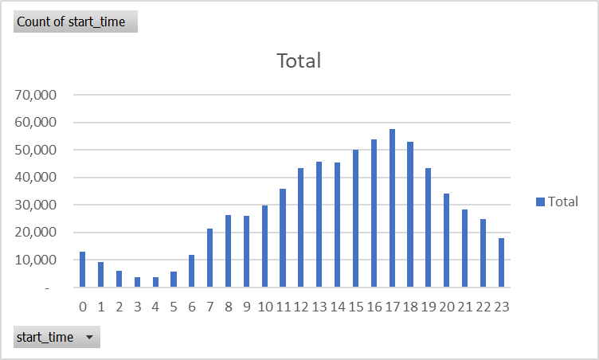
Casuals vs. Members

Slide 6
In this graph both members and casual riders use the bikes at about the same time during the day!

Slide 7
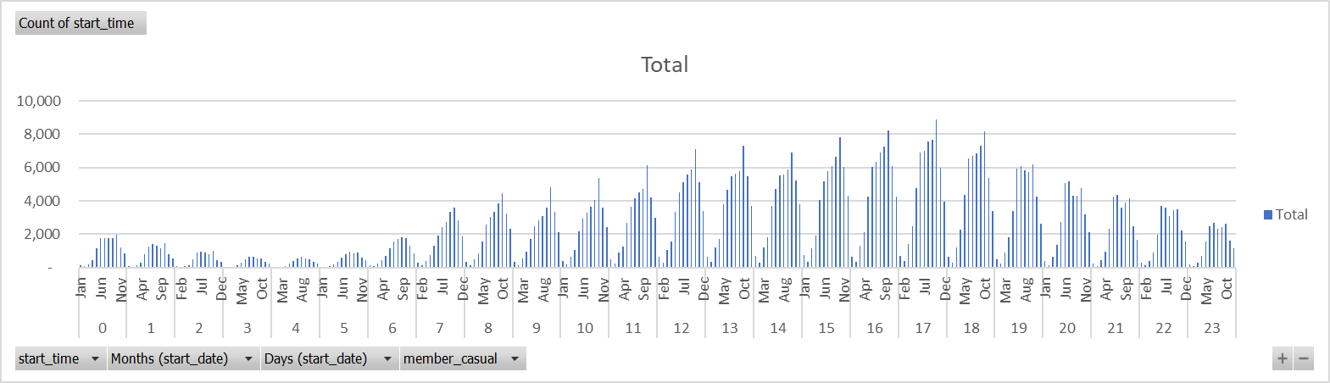
Casuals vs. Members

Slide 8
In this graph both members and casual riders use the bikes at about the same time during the year!

Slide 9
How to Bring in Members
Recommendation 1: “Ride More!” Promotion
Offer a discount to casual riders to use bikes for travel to work or school. Since casual riders already use bikes at about the same time during the day, an emphasis on a wider range of options would be helpful.
Recommendation 2: “Member Reachout Program!”
Give a discount to members who enlist casual riders to become members. Give members who already enjoy the use of bikes a chance to create new ideas for casual bike riders.

